Slide 1
Case Study – Name of Store is JJ Bike – Bicycle Shop
Developed : By Carlos Roberto Martins Castro
Premises : The Store already has a transaction system containing data on its sales. (This data will be simulated)
Gols: Build normalized database (transactional environment) and a data warehouse using dimensional data modeling (analytical environment) to provide data for analysis , obtain insights and build Dashboards for JJ Bike Manager to analyze and understand your business, with the main metrics relevant to business management.
Tools : PostGree , AWS Redshift , AWS Bucket S3 and Microsoft Power BI

Slide 2
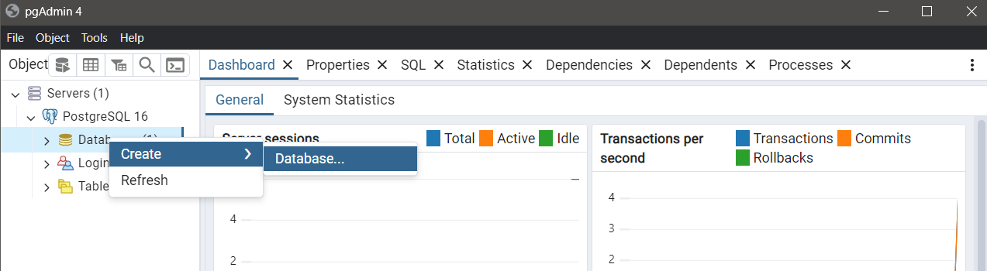
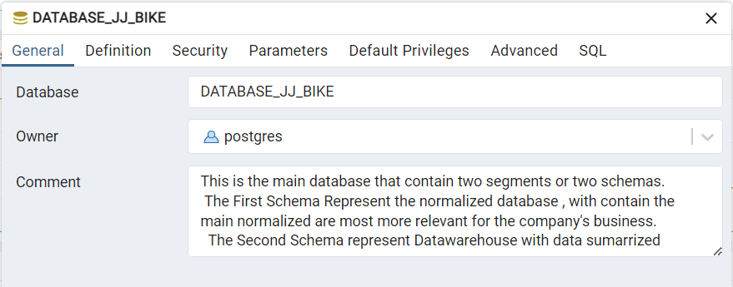
Creating DataBase to PostGree
>> Just access
→ Servers → PostgreeSQL 16 → Create → Database
(Is necessary put the admin password the system ask you when you click in servers option)
>> I gave a name to Database : DATABASE_JJ_BKIKE
>>And I Put a brief description about this database and saved.
Note : Due to PostGre Characteristics , it was necessary created two schemas to separate two differents data strutures, One for Relational Database and another for Dimenssional Database. But in another database , for example in SQL Server , I Would create two separated databases.

Slide 3
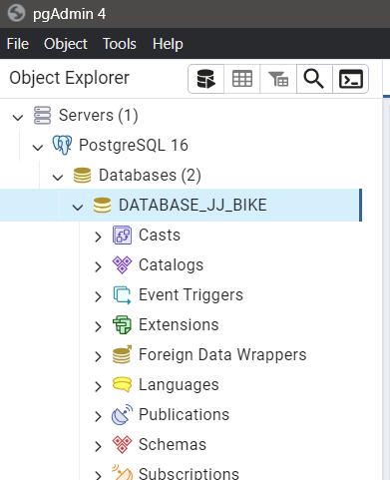
Creating DataBase to PostGree
New Database is created sucessfull !
This is a general structure, in the scheme I will create two structures, one Relational and the other Dimensional.

Slide 4
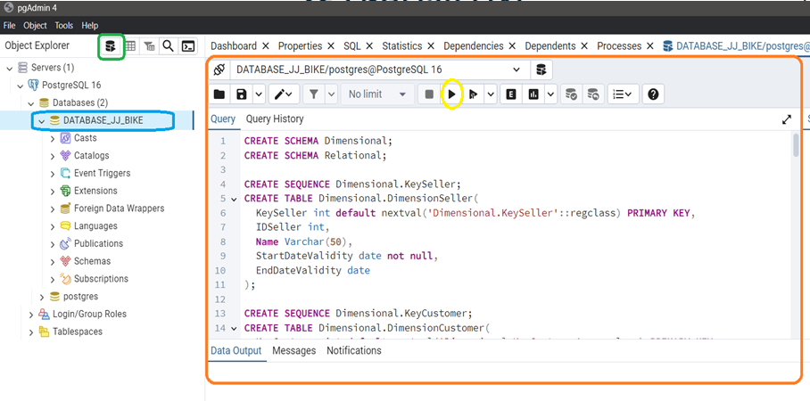

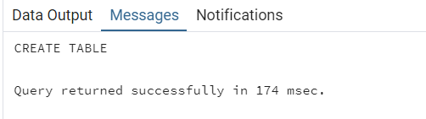
Created Two Schemas, Relational and Dimensional
Script File In GitHub:
If the script execution is successful, the system will display the message below:
On this screen, I show you how to access the tool to run queries, just click on DATABASE_JJ_BIKE highlighted in blue, and click on the green highlighted icon, after that it will open this screen in highlighted Orange and you need to open script 1 – Scripts Create Tables.sql and copy and paste this code to this tool (I put this script on github in the same directory)
To run this code script just click on the yellow highlighted run button

Slide 5
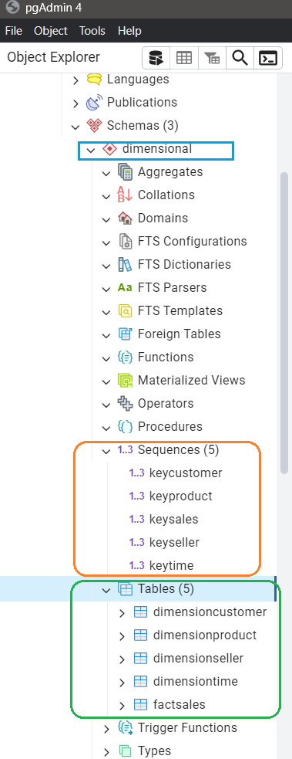
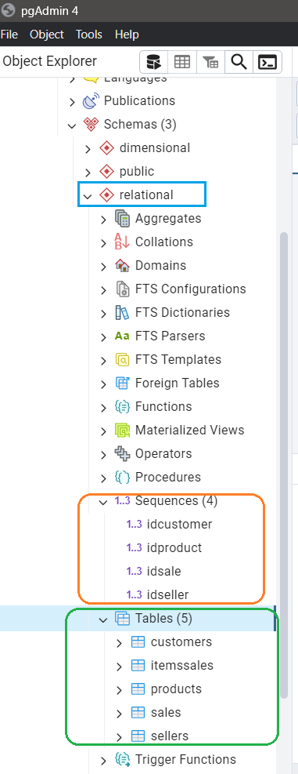
Confirming the creation of tables and constraints
In blue highlight we see two databases in two separate schemas
In orange highlight we see the constraints containing restriction rules to guarantee referential integrity in the database
In green highlight we see the tables created in each database.

Slide 6
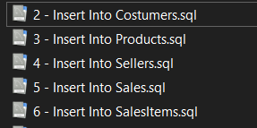
Uploading data to empty Relational tables
In the photo on the side, we can see the list of file scripts that were executed in PostGre's pgAdmin 4 tool that executes queries. (This files are on GitHub)
After finishing the SQL code execution of these files in the query execute tool, we will already have the tables with the data filled in for use in our processes.
This data is simulated data in Brazil, it is not real data, it was created to have a minimum mass of data to work with in our processes.

Slide 7
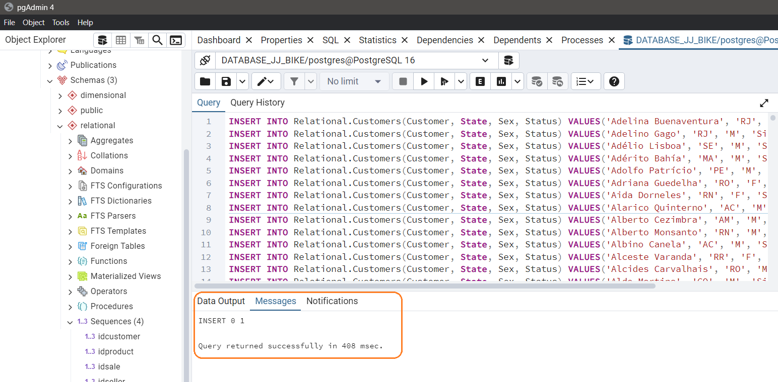
Exemple code fill the tables
On de left side we have an example of the code that fills the Customers table, highlighted in orange we see that the command was successful.

Slide 8
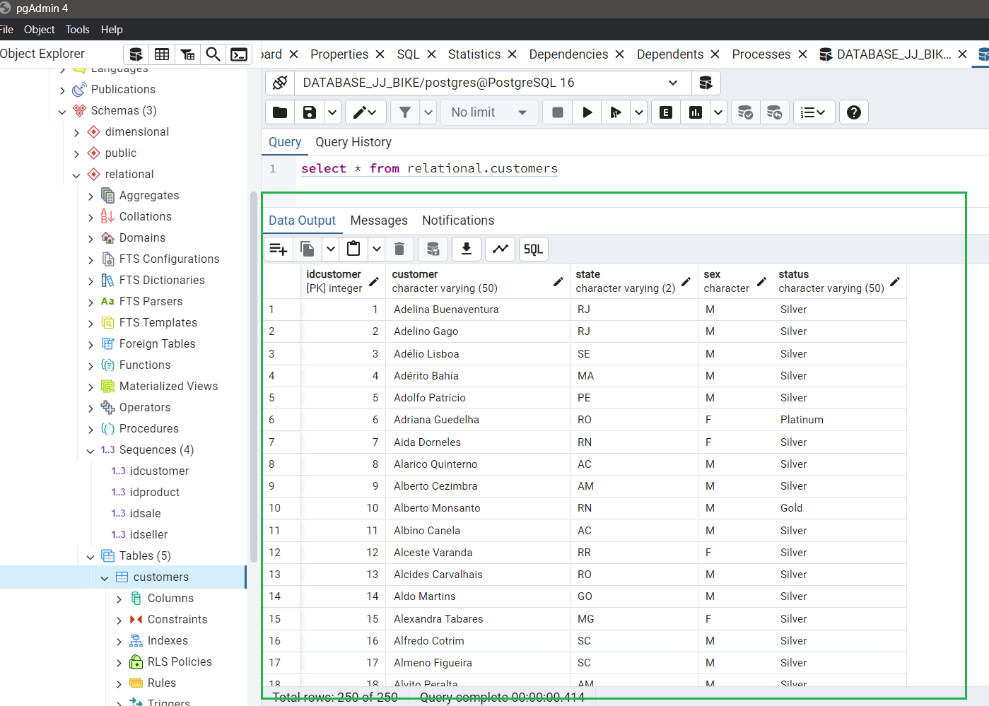
Querying the created table
On the left side, we see the result of the query in the Customers table, with the data highlighted in green.
After completing the execution of the scripts between the numbers in range two and six, the data loading into the relational tables is finished in the postgre database and the next step is to load the data into the dimensional tables.

Slide 9
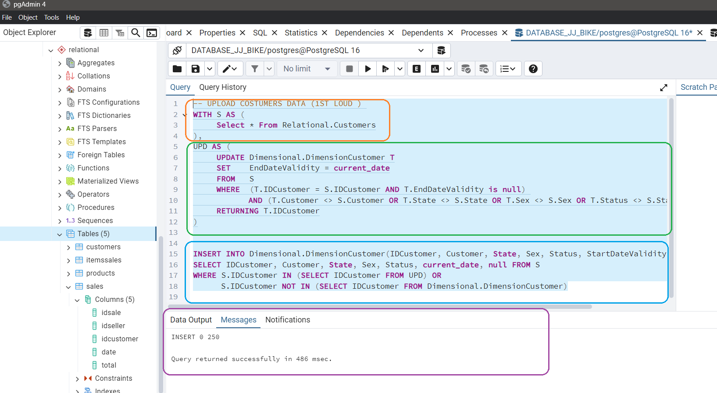
Datawarehouse :
Dimensional Strutures are datawarehouse database tables.
Script :
Uploading data to empty Dimensional tables
In the first example, on the left side we can See the First Code of the Roadmap script - Upload Dimensional.sql (I put this file in GitHub), in this case it loads data into the DimensionCustomer table in the Dimensional database.
In orange highlight, a nickname was created for the relational.customers table and a new table called S was created which is loaded into postgree memory and used in the next query.
In green we can see that a new temporary table was created, the name is Upd, basically this query takes the data from table S (relational.customers) and adds today's date to the field in EndDateValidity , adding expiration date to the data, but only when the conditions of the "where" clause are met, in this case it checks whether the record exists or not, if so the system updates the EndDateValidity field, otherwise it does not update, so the objective is to update the table field with new changes, and add an expiration date to the record and have redundancy in the data warehouse to allow you to see changes over time, in this case when the EndDateValidity field is null it represents the most up-to-date data, but if it has a date it means there are historical changes in this registration and the date means the period in which the changes took place
In the blue highlight we can see the insertion of Data from the S and UDP temporary tables into the Customer Dimension table in the dimensional database
In the yellow highlight we can see that the command was executed successfully

Slide 10
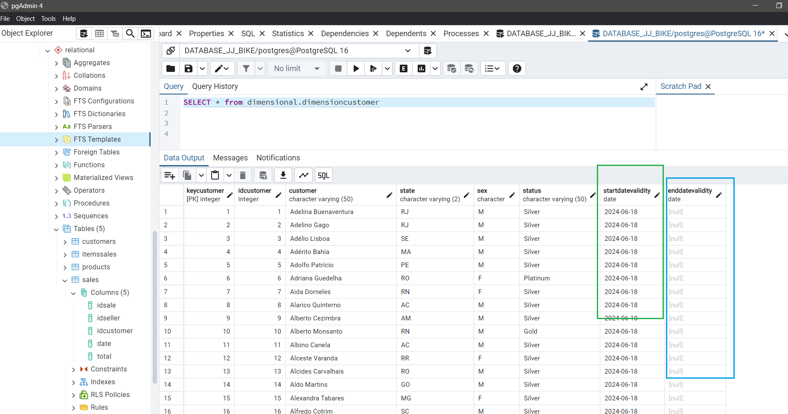
Viewing data in the Dimension Customer table for the first load
We can see that we already have data in DimesionCustomer.
But in the green highlight we only have the start date filled in.
In the blue highlight we see that we only have empty data here, this is because only the first data load was executed in this table, and there is no new data changed in the database so far, but in the second update the data in this column will change because it will change and the history will be maintained in the Data Warehouse.

Slide 11
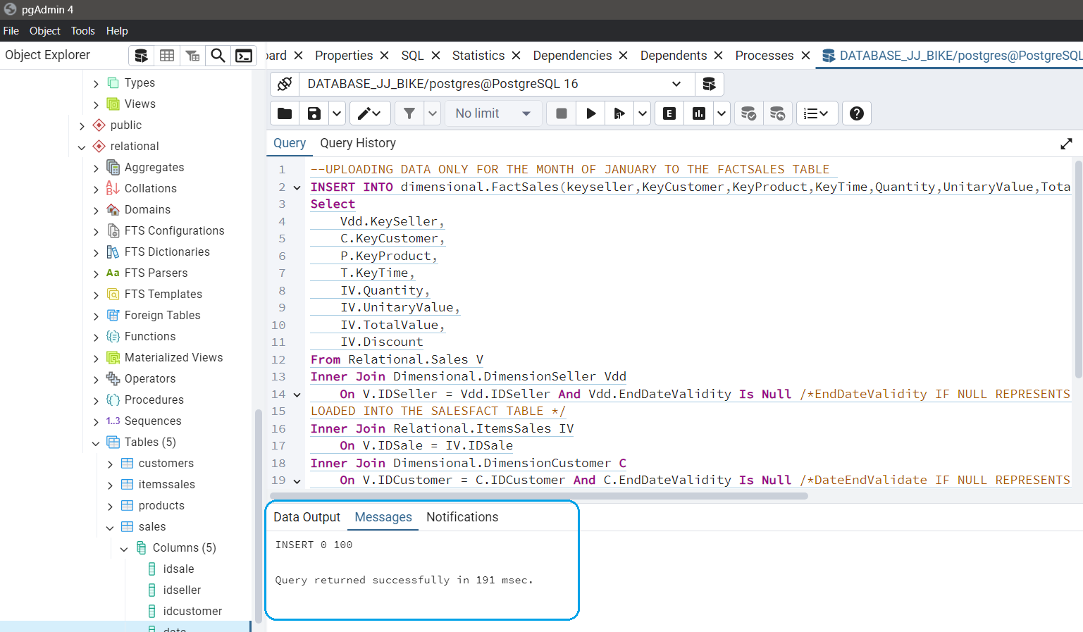
Making the first load of the FactSales Dimensional table in database
The loading of the dimensional tables, Customer, Product, Salesperson and Time dimensions has already been completed. Now we will load the fact dimension into the FactSales table in the dimensional database.
We see in the screenshot on the left side highlighted in blue, the command to load the FactSales Table was executed and was successful, in this first stage only one month was loaded, the month of January. This happened to simulate changes to the transactional database and how to maintain historical information in the Data Warehouse, these changes will be made in the next steps.

Slide 12
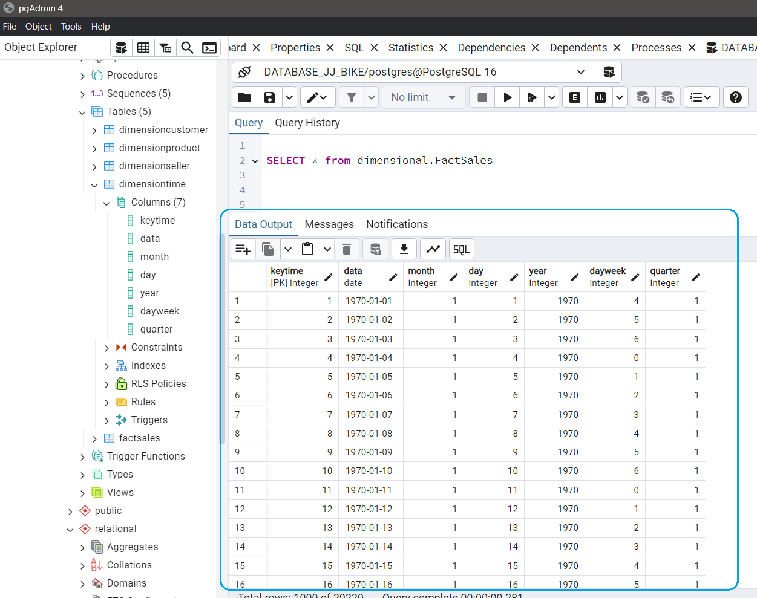
Viewing data from the FactSales table
We can see in the blue highlighted screenshot on the left side, the data loading in the FactSales Table of the Dimensional database was loaded out successfully, this is the first load.

Slide 13
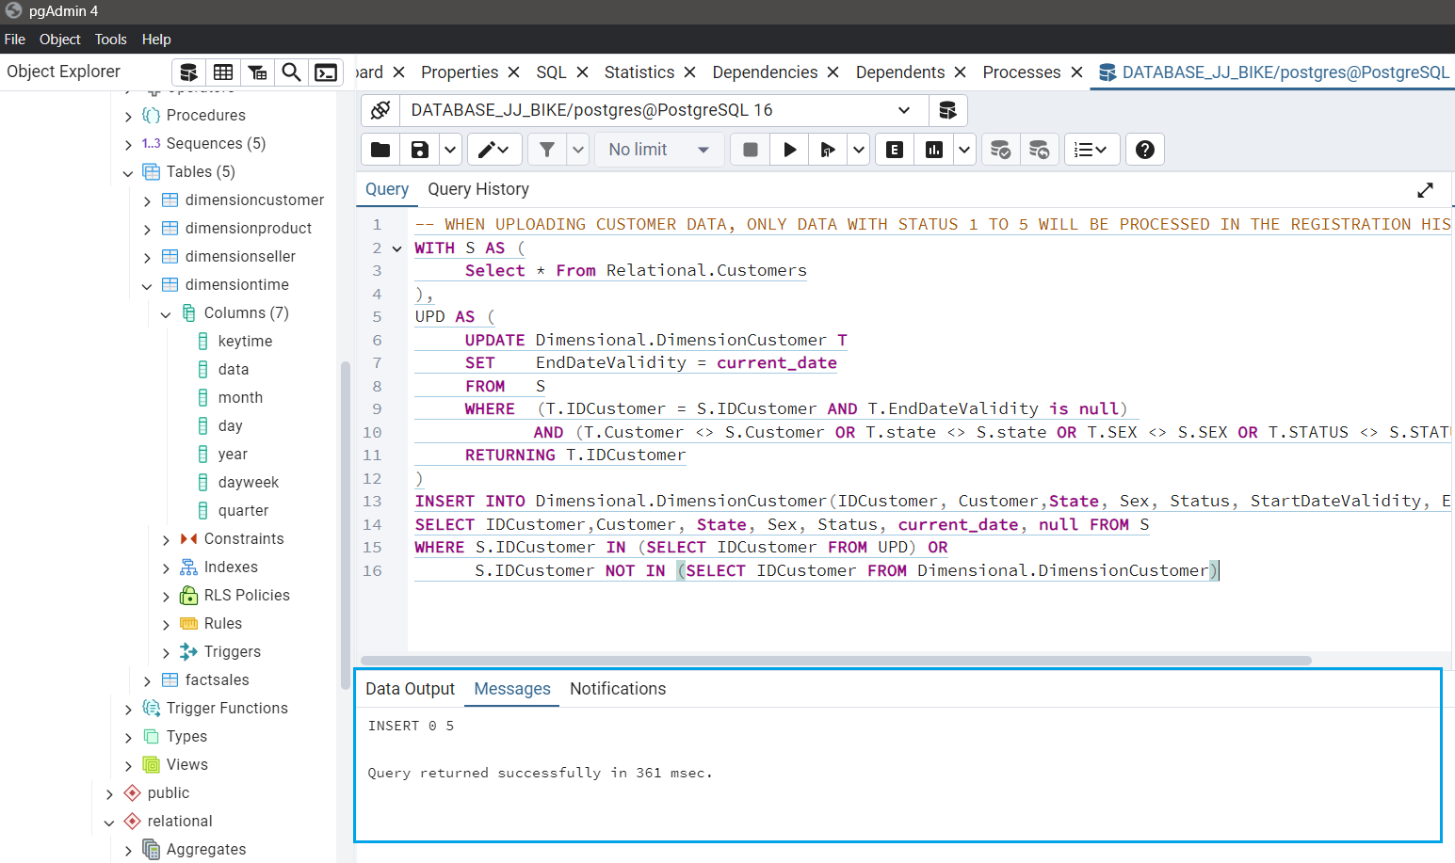
Making Update in Customer Table in Relational Database
Below changes were made to the Customers Table in the relational Database, in the status field the idcustomer status was changed with the range between 1 to 5 changed to Gold Status.
In this case, these changes aim to simulate a change in the transactional database, representing an improvement in the relationship of these Customers with the company and in the case of the rewards program, these customers have moved up a level, which means they have gained more benefits from the company, such as discounts. and promotions.
On the left side we can see the second update in the Customer table in the dimensional database, but now with the new update in the records in the Customer table in the Relational table
The blue highlight shows that the query execution was successful.

Slide 14
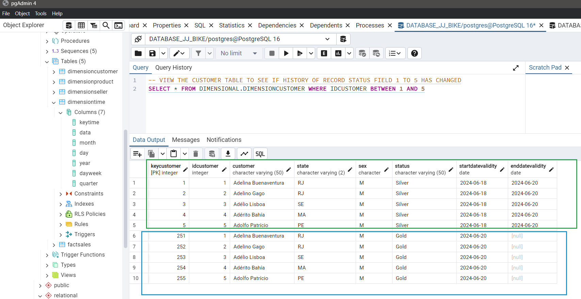
Historical changes preserved in the Data Warehouse made in a transactional environment
Maintained historical changes that occurred in the relational database in the dimensional database or data warehouse. (Even if these changes were lost in the transactional environment of the database).
In this case, the original code compatible with the transactional environment associated with the old silver status is maintained in the field keycustomer (customer foreign key).
And a new code is added for the customer key field associated with the new gold status, in this way the association is correctly made with the FactSales table in the dimensional database and in this way we can retrieve sales data from sellers for each situation with new status and status old and the idcustomer field keeps the original code.
We can see in green hightlight the oldest records with the enddatevalidity field filled .
And in the blue highlight we can see new records with empty enddatevalidity meaning that this data is more up to date

Slide 15
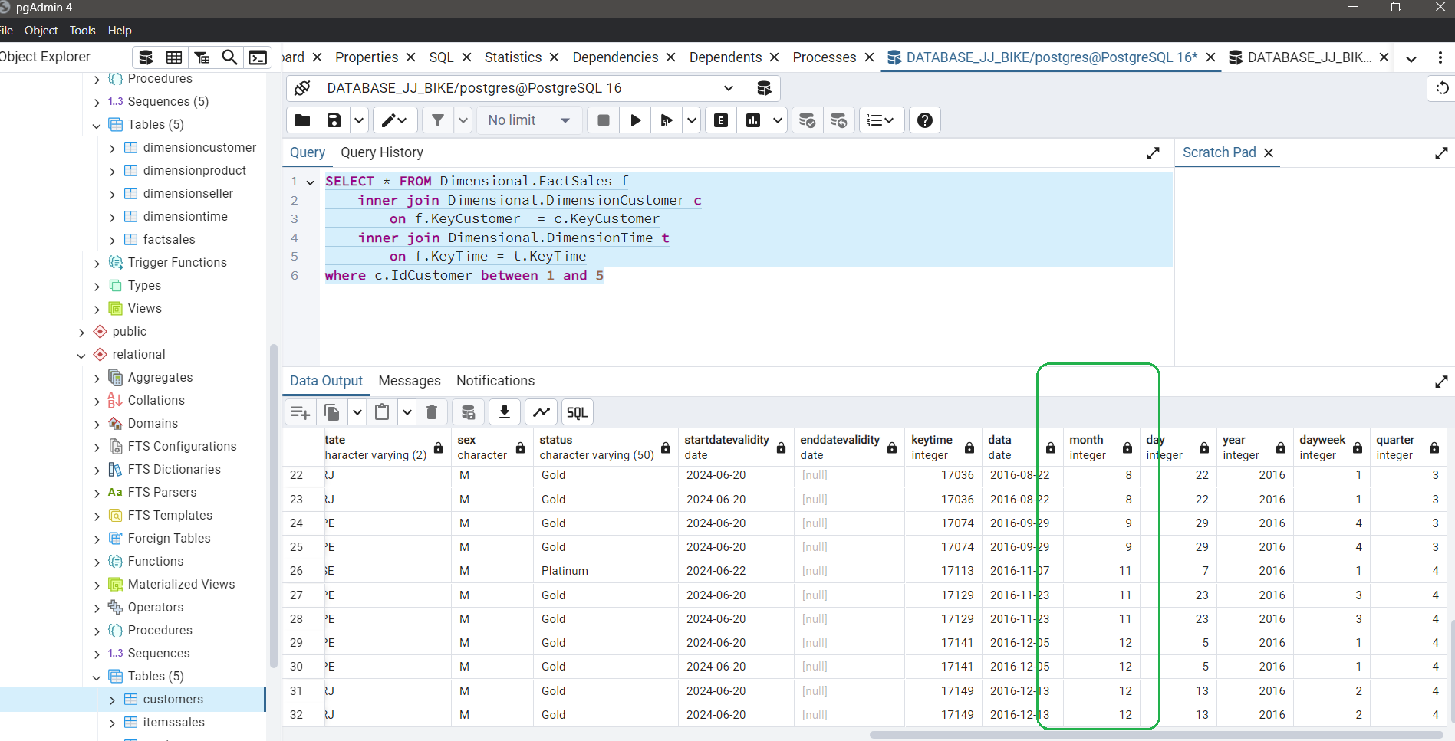
Loading of all tables into the Data Warehouse has been completed
The data was loaded into the Data Warehouse for months 1 to 3 (January to March), the changes that occurred in the transactional database were loaded in the status field, and in the Data Warehouse in the FactSales dimensional table, the history of the changes that occurred are recorded in the field status, available for analysis of past information about this data. (the entire script is available on GitHub, the name is Roadmap - Upload Dimensional.sql).
The process of loading the tables into Data WareHouse is complete, and on the left side we can see highlighted in green all the months that are loaded into the Dimensional Database in the FactSales table containing one year of information about sales at JJ Bike Company

Slide 16
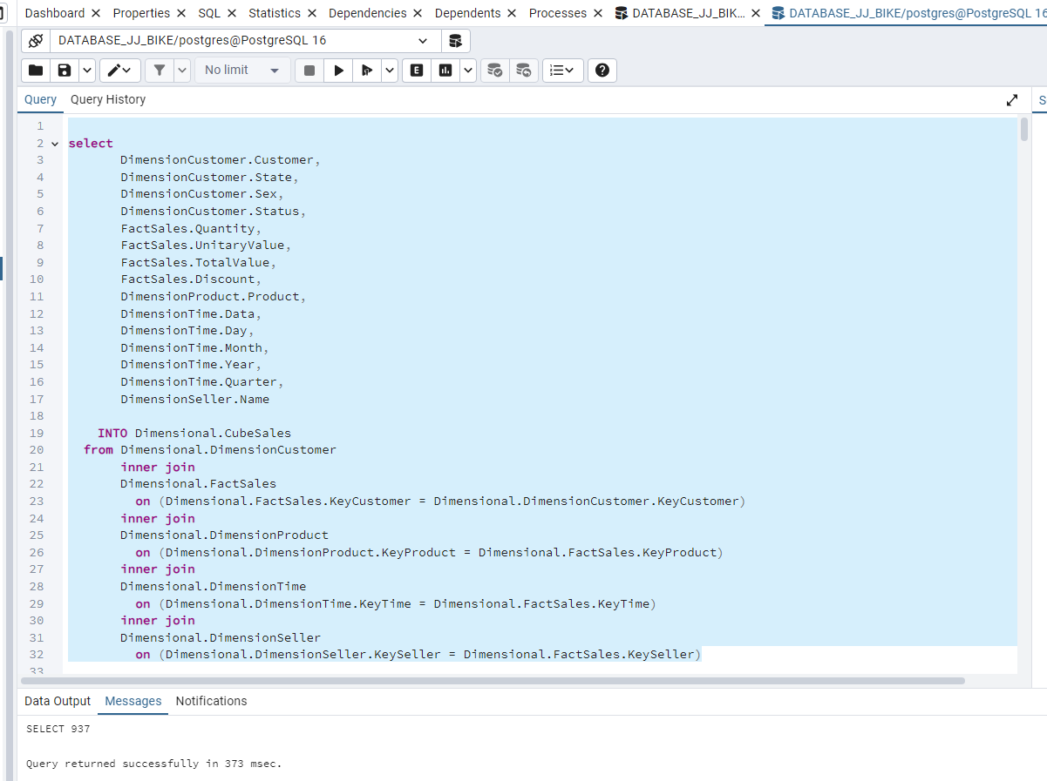
Creating cube table in Dimensional database
Above we can see the name of the file with this script available on GitHub of this project, the name is "9 - Cube.sql“.
On the left we can see the command to create the new table called "CubeSales" in the Database Dimensional Schema. This table contains the main dimensions of sales transactions.
With Cubo we can easily generate development reports and can be used to extract different types of analyzes for different areas of the company, even without much technical skill.

Slide 17
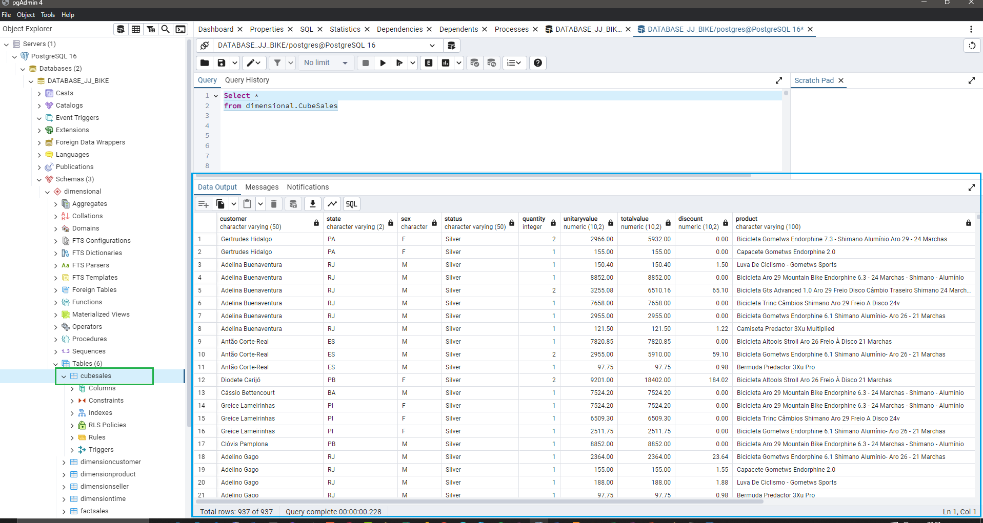
Creating cube table in Dimensional database
Below, highlighted in green, we can see the new table created.
And in the blue highlight, we can see the data we have in this table.

Slide 18
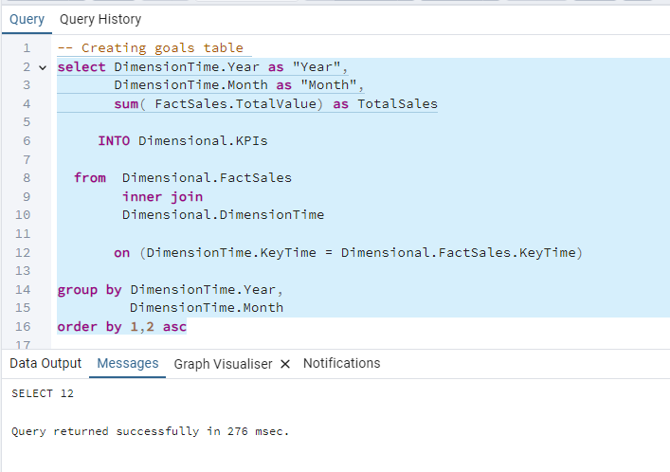
Creation of the Goal Table – Initial Structure
Here we are creating the table initial with the main fields year, month and total , after that we will creating the field with the goals of salesperson.

Slide 19
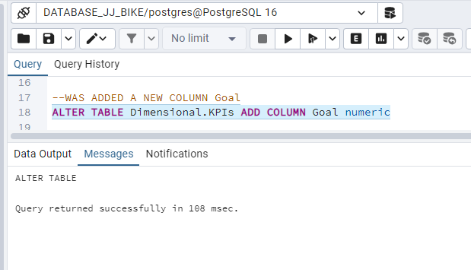
Added Field "goal" in KPIs Table

Slide 20
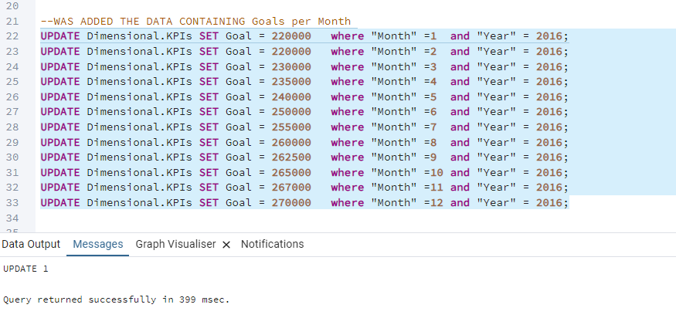
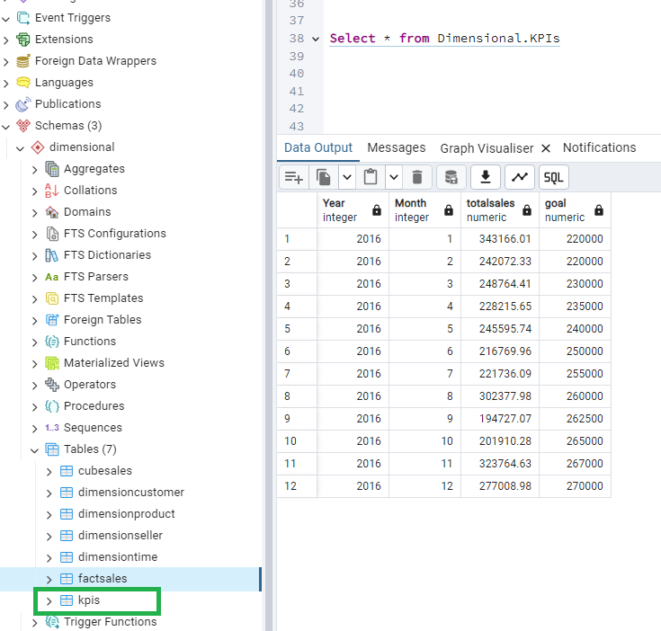
Here we update the goal field in the KPIs table, we add the goal information for the year 2016, if in the future we need to add new goals for new years, we use the same code just changing the year and the values ​​in the goals.
In the green highlight we can see that the kpis table was created in the dimensional scheme.
Here we have the KPIs table loaded with goal data.
This code script is placed on GitHub in the scripts directory, the file is called "10 - kpi.sql"

